Slide 1
Unit 2 Dinner is ready!

Slide 2
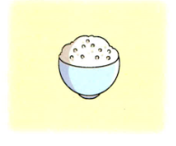
rice

Slide 3
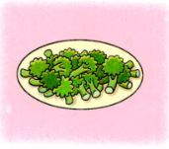
broccoli

Slide 4

fish

Slide 5
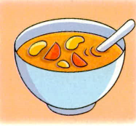
soup

Slide 6
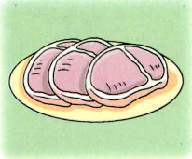
meat

Slide 7
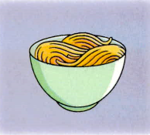
noodles

Slide 8
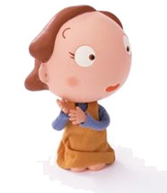
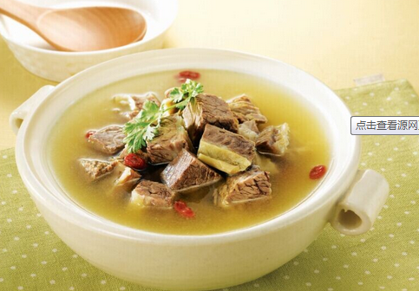

Have some soup, please!
Thank you!

Slide 9
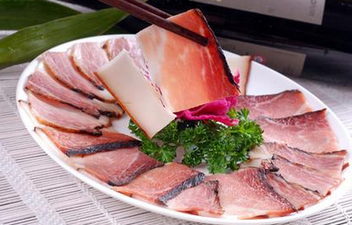
Have some meat, please.
Thank you!

Slide 10
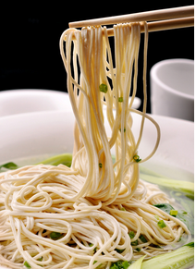
Have some noodles, please.
Ok!

Slide 11
Let's play!

Slide 12


Have some soup, please!

Slide 13
Have some meat, please!

Slide 14
Have some fish, please!

Slide 15
Homework
1.请同学们把今天学的对话读熟。
2.请把今天学的新短语写在作业本
上，每个写两遍。

Slide 16


Thanks, bye!

